Slide 1

BY
DO GOOD
W E M A K E T H E
D I F F E R E N C E

Slide 2
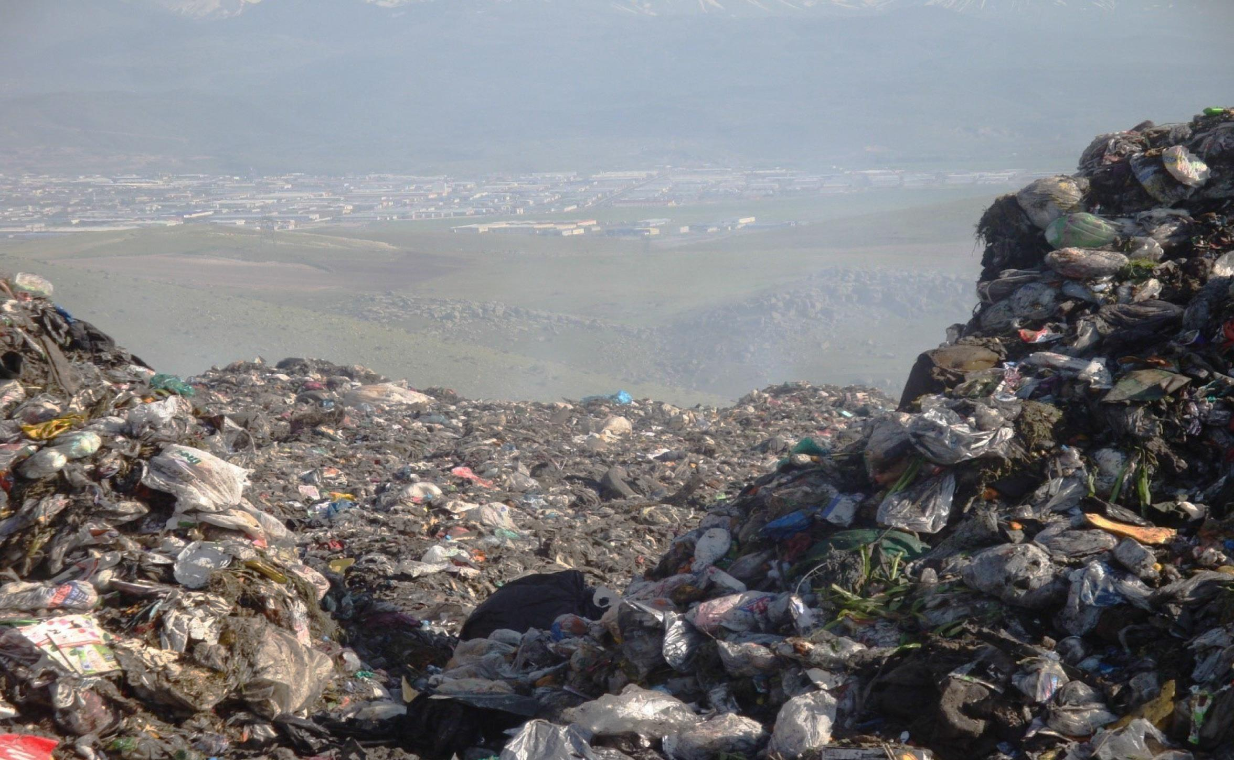
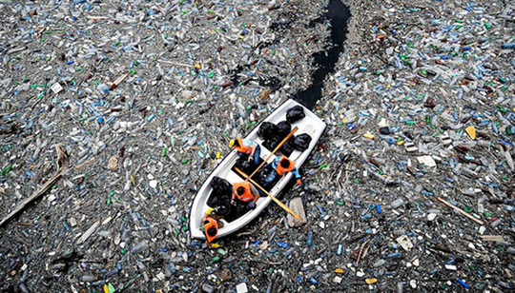
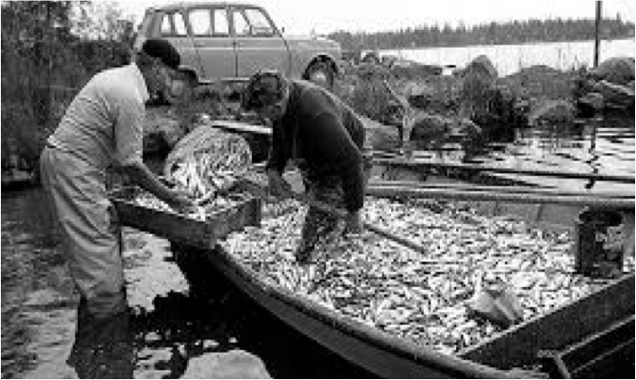
TRASH
TO
CASH
Notes:
Change from fossil dependence
New Oilfields
Clean the Ocean

Slide 3
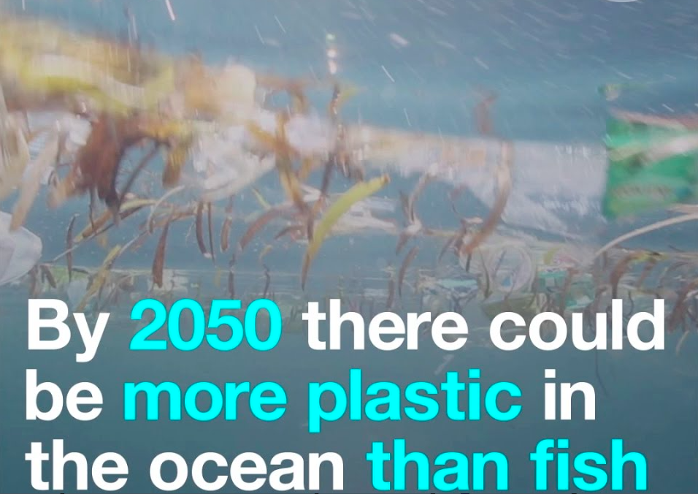
MACRO AND MICRO PROBLEMS
Images text and numbers containing
Population
Increasing consumption ex textile
Notes:
SWESTEP has a new innovation to trwl up all the plastics in the ocean and with a SWESTEP plant on the ship we can clean the ocena and at the same time produce diesel for the boats out in the ocean

Slide 4
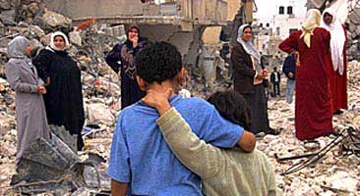
CAN WE MAKE DIFFERENCE ?
Earth quake
Sunami
War
Refugee camps
Nature catastrophes

Slide 5
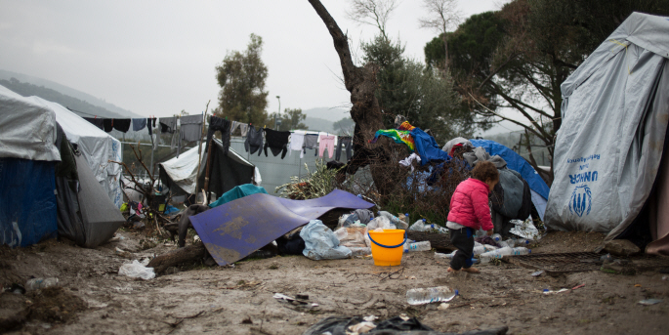
REFUGEE CAMPS

Slide 6
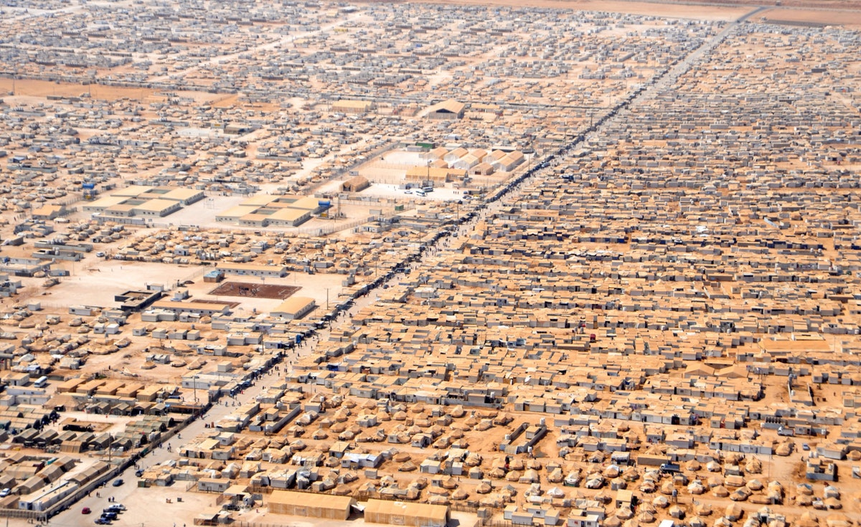
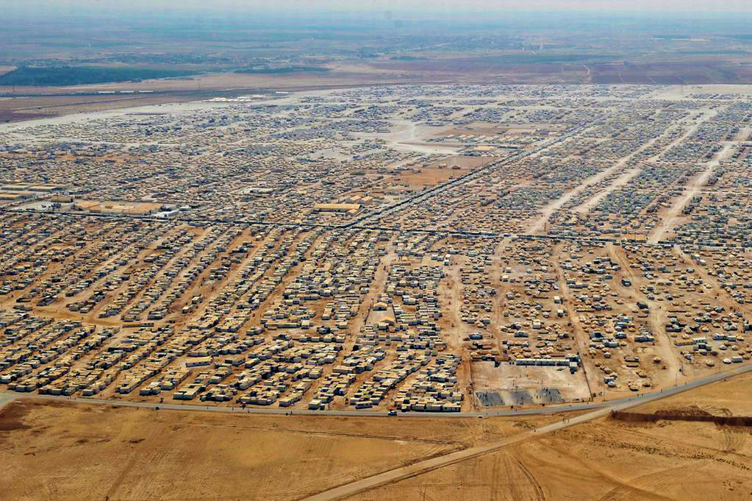
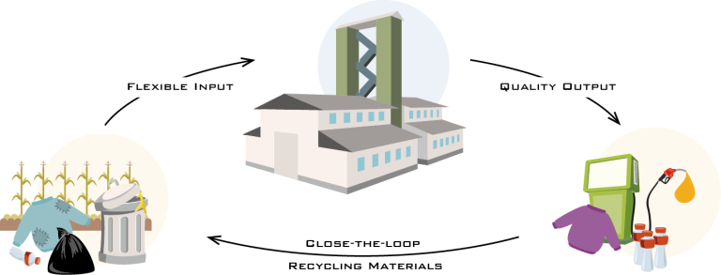


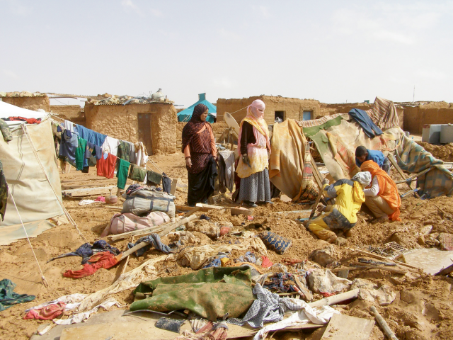
MILLIONS LIVE TODAY IN REFUGEE CAMPS
THE PROCESS
SCALABLE – FLEXIBLE – MOBILITY
FRONT END
CPD PROCESS
BACK END
Scanning, Analysis, Separation
Drying, Shredding, Regulation
of PH Value and Speed on
Conveyor Belts and Feeding
Refining,
Desulphurization, Distillation and Storage
Catalytic Depolymerisation Process. Mixer and Turbine. <10 min from input to output. 100 - 12,500 l/h
in production capacity depending on size of plant
Notes:
MILLIONS OF PEOPLE
WASTE
CREATE ELECTRICITY PRODUCE DIESEL AWATER AND ASPHALT

Slide 7
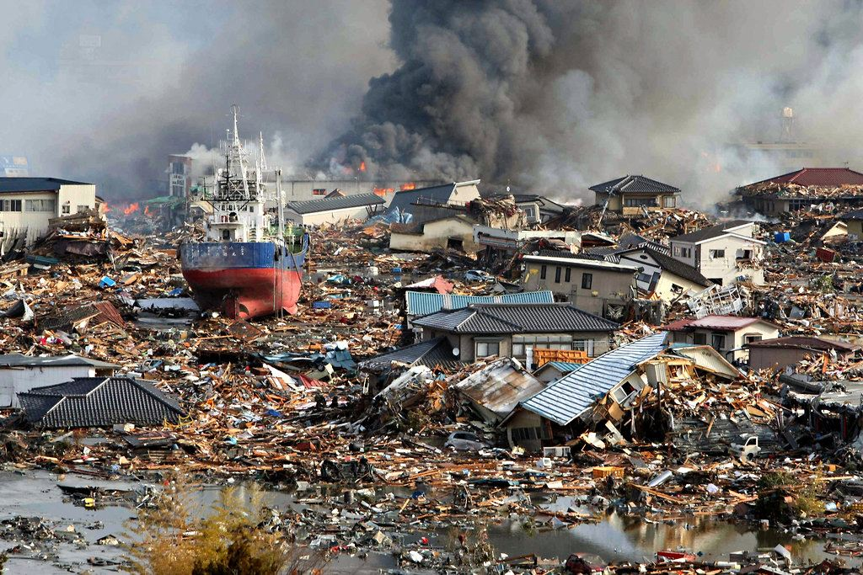

Slide 8

WHY SO COMPLICATED ?
Notes:
Who are the mist honest and straight forward ? The children From a child's perspective
What is the problem?
Just fix it!

Slide 9
WASTE MANAGEMENT
Clean up
Residuals are assets and can contribute to change the world
Create a circular economy and renewable products

Slide 10
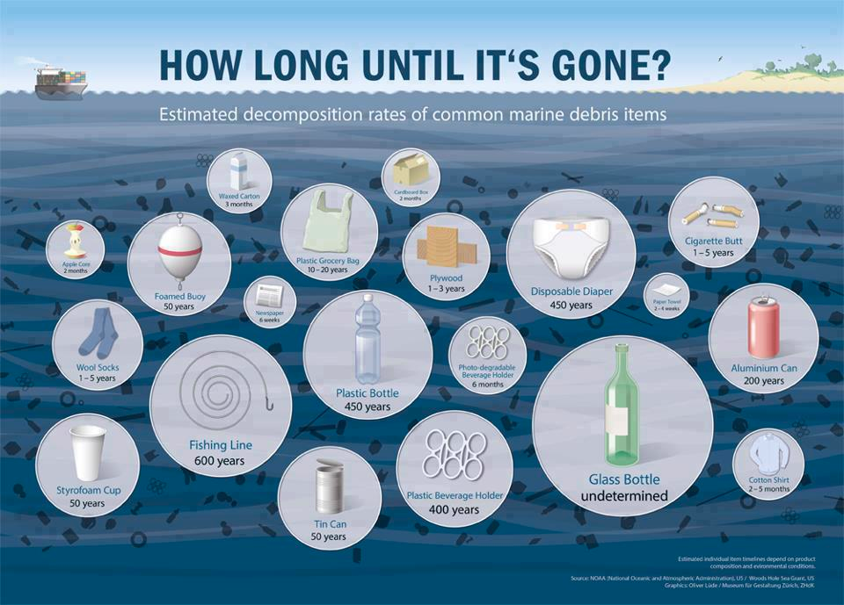
PLASTIC END OF LIFE TIME ?....

Slide 11
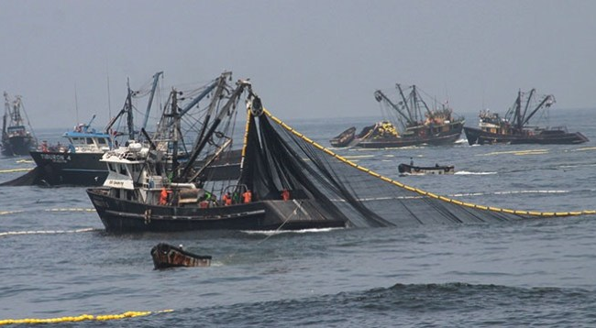
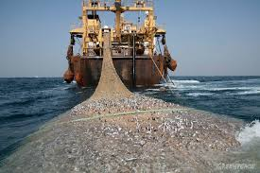
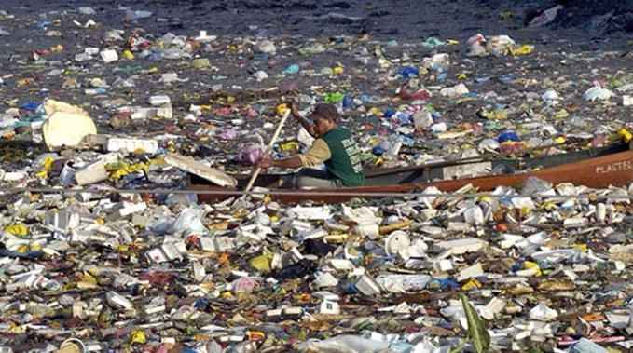
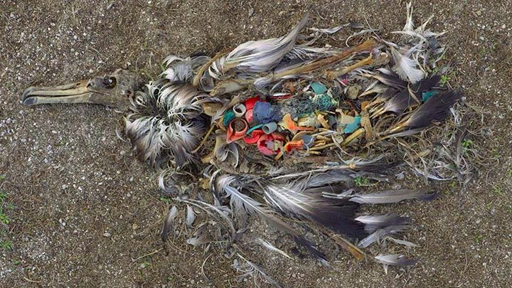
Responsibility for coming generations !

Slide 12
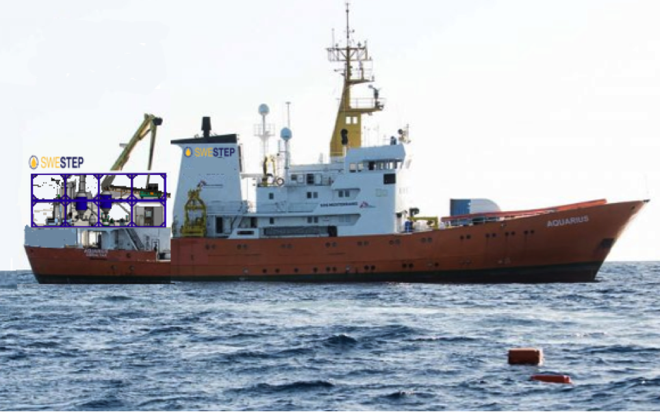
MY VISION
Notes:
TO CLEAN THE OCEANS
TO CLEAN THE LAND
TO CLEAN THE AIR

Slide 13

THIS IS OUR SOLUTIONS

Slide 14



HYDRO & WATER
WIND
SUN
Notes:
THE RENEWABLE ENERGY PORTFOLIO
What is the missing piece of the puzzle
The renewable energy Portfolio must be balanced and viable.
Sustainable alternative for fossil dependent industries and the transport sector
Set in the timeline by UN,EU, OECD and IEA goals according to CO₂ Emissions and global warming

Slide 15


HYDRO & WATER
WASTE
WIND
SUN
Notes:
The competitors
HVO
Biogas
Biodiesel
Renewable Fuels for:
Air
Land
Sea
Raw material or Chemical Industries
Textile
Plastic
Cosmetic
Food

Slide 16
INNOVATION CPD FROM WASTE

Slide 17
WASTE STREAMS
STREAMLINE AND SIMPLIFY
ORGANIC
MATERIALS
- Including Plastic
INERT
MATERIALS
Glass - Metals – Ceramics - Stones

Slide 18
OVER CONSUMPTION
Warmer climate
Pollution
Energy explotation.
Economy
Politics
Lobbyism
Nature explotation
Desserts
      Melting ice
      Less land
      Less vegetation
      War
      Less food
      Molten tundra
      More epidemies
      Fire
      Pollution
      Greed

Slide 19
NO NEED FOR CHANGE
INFRASTRUCTURE
MACHINERY ENGINES
INDUSTRY

Slide 20
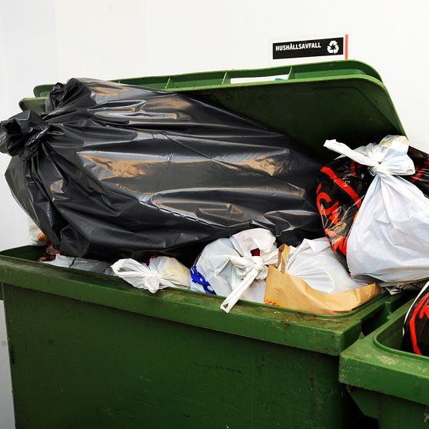
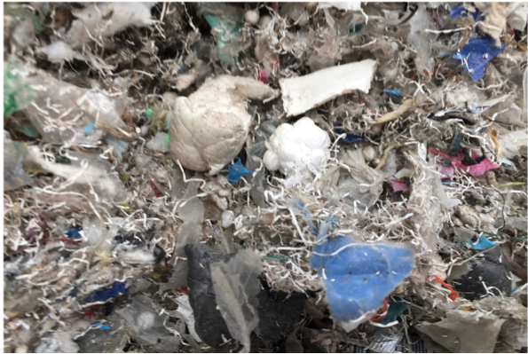
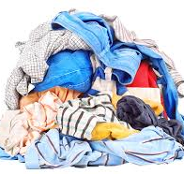
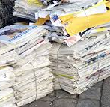
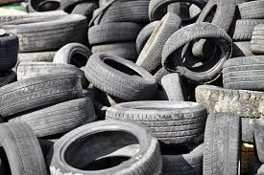
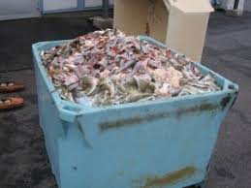
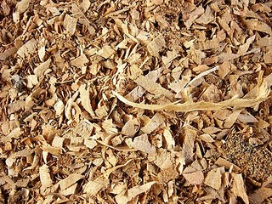
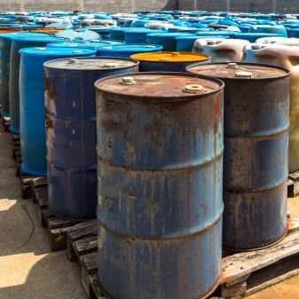
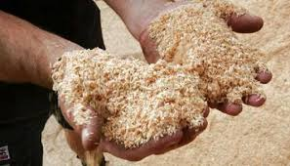
HOUSE HOLD
WASTE
PLASTIC
WASTE
TEXTILE
WASTE
PAPER
WASTE
USED TIRES
WASTE
SLAUGHTER
RINSE
BIOMASS
WASTE
USED OIL
WASTE
LIGNINE
WASTE

Slide 21

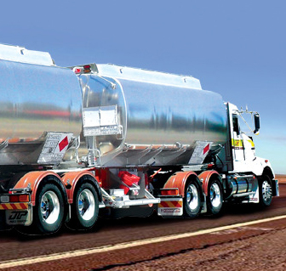
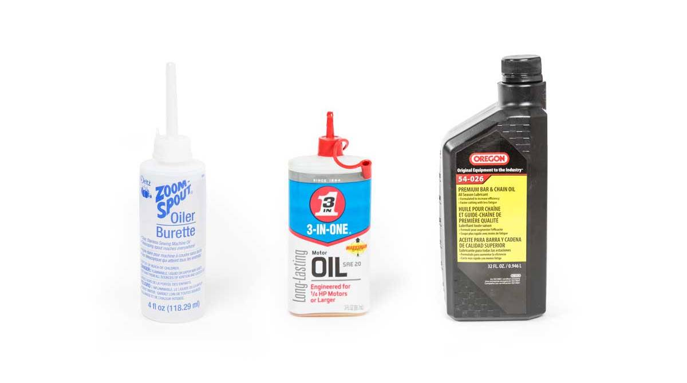


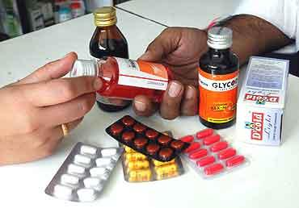




FUEL
AIR LAND SEA
LUBRICANTS
Oil and BINDING MATERIALS
PARAFFIN'S
ADDITIVES
TEXTILE
FASHION
MEDICAL
CHEMICALS
COSMETICS
FOOD
WATER
H₂O
ASPHALT
BITUMEN
CARBON DIOXID
CO₂

Slide 22
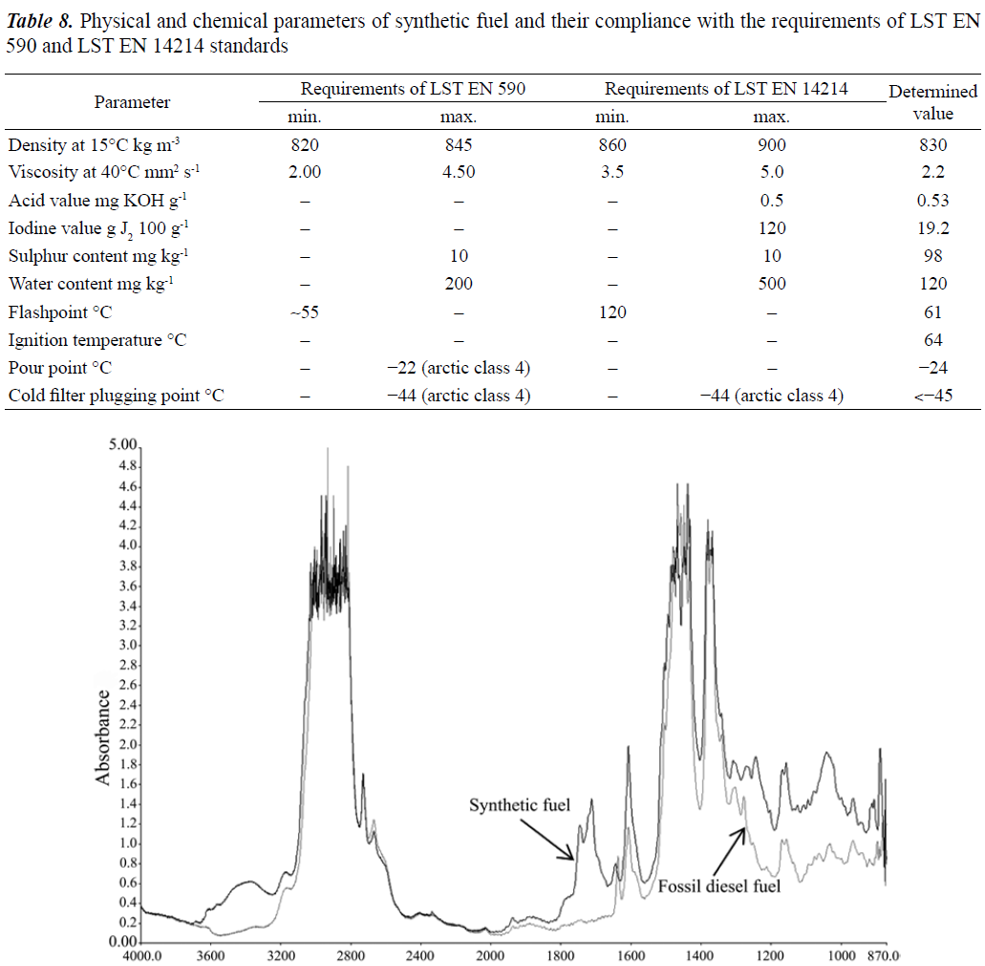
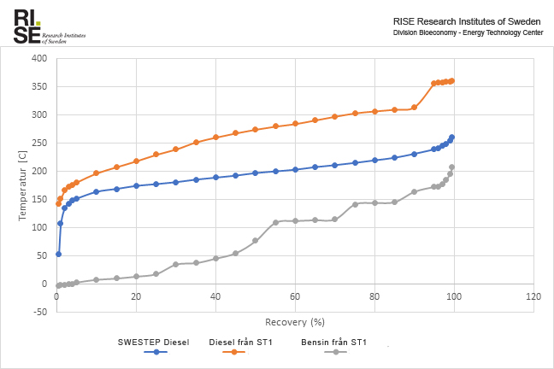
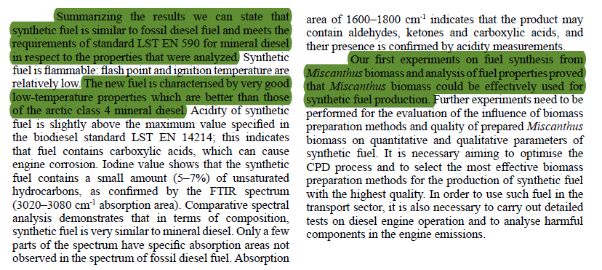
TEST & LABB
REPORTS – PROOF OF CONCEPT
SOURCE - Agricultural University, Kaunas, Lithuania. RISE - Energy Technology Center, Piteå, Sweden

Slide 23
CLIMATE FRIENDLY ECONOMY IN CLIMATEFRIENDLY WAY
NEW INNOVATION
NO CAHNGES OF INFRASTRUCTURE
REUSE
RENEW
CIRCULAR ECONOMY
WASTE MANAGEMENT

Slide 24
THE MARKET
REGULATIONS – LAWS – EXPECTATIONS
OPENS UP THE MARKET FOR SWESTEP
INFLUENCE
FACTORS
Notes:
1. CLIMATE CHANGE 2. OIL CONSUMPTION 3. AVIATION FUELS 4. SYNTHETIC 5. TEXTILE FIBER PRICE 6. FORECAST OIL 7. POLITICAL DECISIONS 8. GATE FEE – FEEDSTOCK 9. GROWING WASTE HANDLING PROBLEM 10. GLOBAL GROWING POPULATION

Slide 25
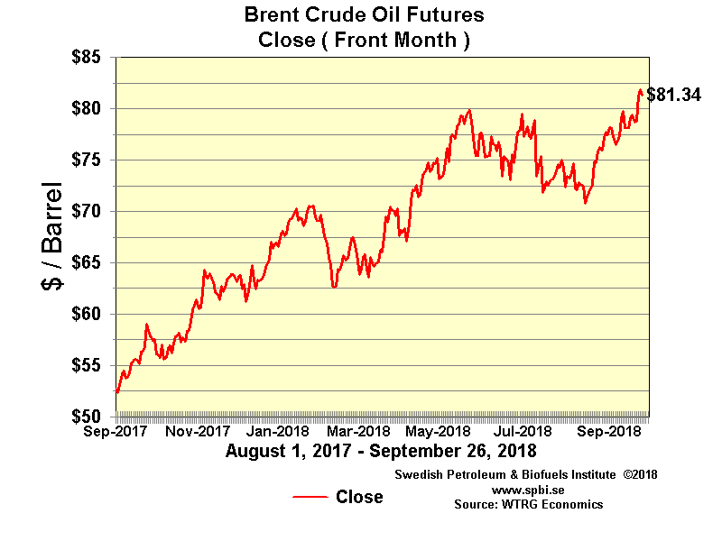
TODAY’S PRICE - RAW OIL IMPORT

Slide 26
GROWTH DEMANDS PRICES
FORECAST
2000 2010 2020 2030 2040 2050
DEMAND – PRICE- GROWTH
POPULATION OIL PRICE
SOURCES - UN, EU, OECD and IEA
POPULATION – The current world population of 7.6 billion is expected
to reach 8.6 billion in 2030, 9.8 billion in 2050 and 11.2 billion in 2100,
according to a United Nations report
OIL PRICE – The current oil price per barrel (latest)is $ 80. 2020 is predicted to reach between $90 to $400.
Notes:
TEXTILE INDUSTRY The Polyester Fibers Market Value Was 2016 $ 27 Billion
AVIATION SECTORE One (1%) Percent Market Share Of Renewable Jet Fuel Is Worth $ 440 Million

Slide 27
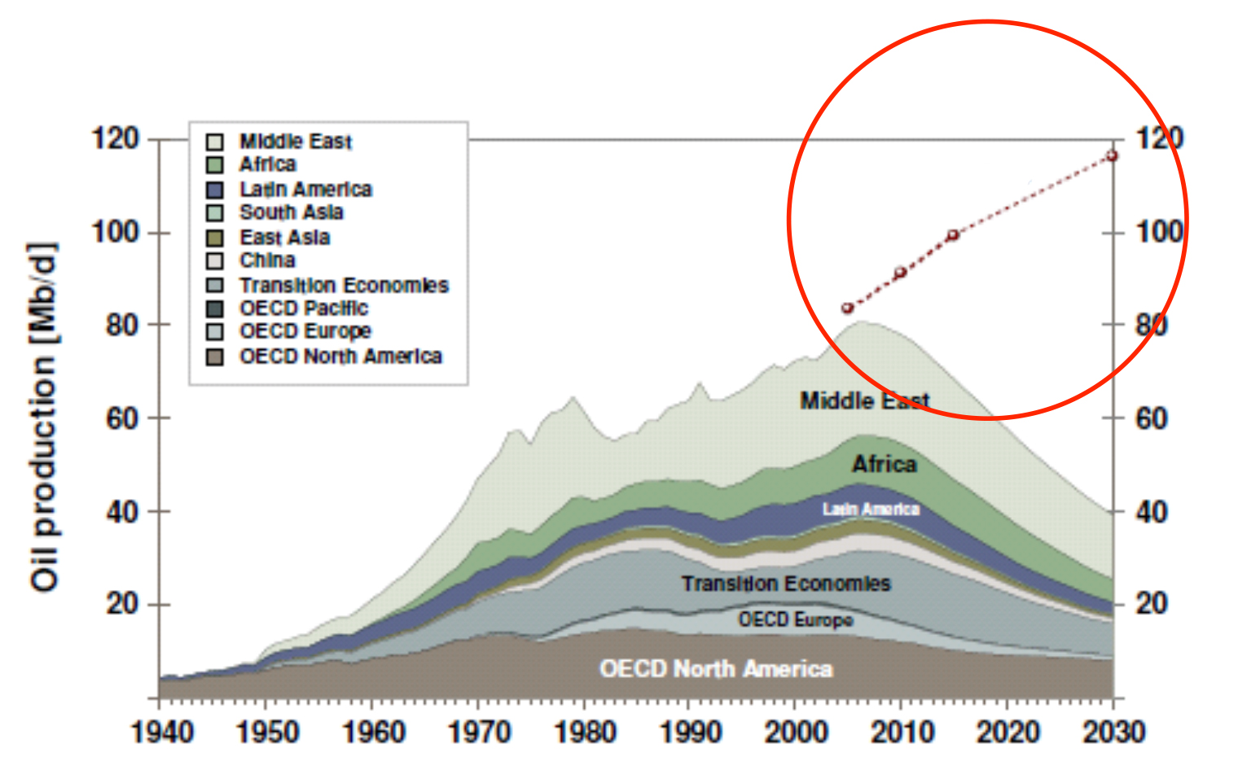
OUR MARKET
PREDICTED MARKET SHARE FOR SWESTEP
SOURCE - WEO
Notes:
TEXTILE INDUSTRY The Polyester Fibers Market Value Was 2016 $ 27 Billion
AVIATION SECTORE One (1%) Percent Market Share Of Renewable Jet Fuel Is Worth $ 440 Million

Slide 28

OUR NEXT GENERATION READY TO TAKE OVER
.
Notes:
Society decision makers and businessmen have the greatest responsibility.
The bigger the company, the greater the responsibility.
This applies to all doing actions and it comes to all who make decisions.

Slide 29
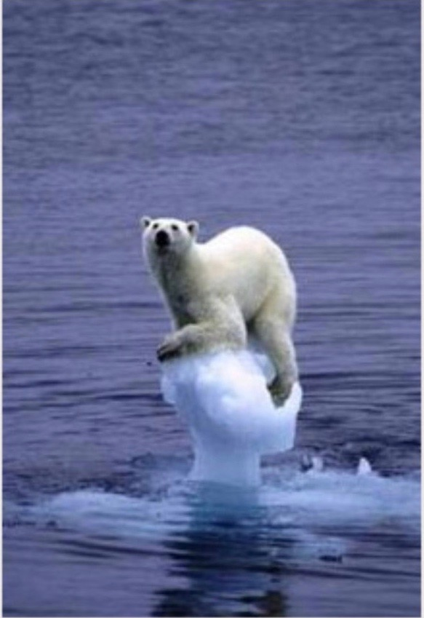
WE ONLY HAVE ONE LIFE AND ONE WORLD
AND ITS OURS AND IT CAN BE WONDERFUL !
THANK YOU!

